Slide 1
UNIT-I
INTRODUCTION

Slide 2
CONTENTS
Network Hardware
Network Software
OSI, TCP/IP Reference Models
Example Networks: ARPANET, Internet
Physical Layer:
Guided Transmission media
Twisted Pairs
Co-axial Cable
Fiber Optics
Wireless Transmission

Slide 3
NETWORK HARDWARE
There is no generally accepted taxonomy into which all computer networks fit, but two dimensions stand out as important: transmission technology and scale.
Broadly speaking, there are two types of transmission technology that are in widespread use:
broadcast links and point-to-point links.

Slide 4
Point-to-point links
Point-to-point links connect individual pairs of machines.
To go from the source to the destination on a network made up of point-to-point links, short messages,
called packets in certain contexts, may have to first visit one or more intermediate machines.
Often multiple routes, of different lengths, are possible, so finding good ones is important in point-to-point networks.
Point-to-point transmission with exactly one sender and exactly one receiver is sometimes called unicasting.

Slide 5
broadcast links
In contrast, on a broadcast network, the communication channel is shared by all the machines on the network; packets sent by any machine are received by all the others. An address field within each packet specifies the intended recipient.
Upon receiving a packet, a machine checks the address field. If the packet is intended for the receiving machine, that machine processes the packet; if the packet is intended for some other machine, it is just ignored.
A wireless network is a common example of a broadcast link, with communication shared over a coverage region that depends on the wireless channel and the transmitting machine.
Broadcast systems usually also allow the possibility of addressing a packet to all destinations by using a special code in the address field. When a packet with this code is transmitted, it is received and processed by every machine on the network. This mode of operation is called broadcasting.
Some broadcast systems also support transmission to a subset of the machines, which known as multicasting.

Slide 6
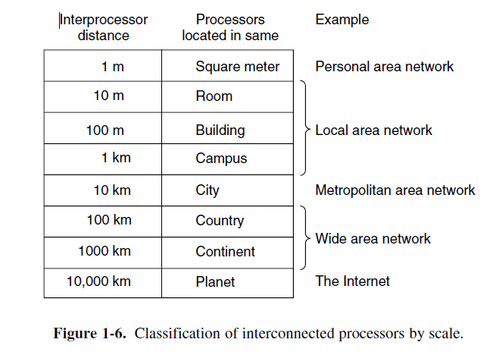
SCALE
An alternative criterion for classifying networks is by scale. Distance is important as a classification metric because different technologies are used at different scales.
In Fig. 1-6 we classify multiple processor systems by their rough physical size. At the top are the personal area networks, networks that are meant for one person.

Slide 7
What is a computer network?
What is a computer network? | A network is a group of computer and other devices connected together.
Create a list of the activities computer networks make possible.
Activities
Share files and data
Share printers
Communication (email, social media etc)
Streaming content (videos, TV music)
Storing data (cloud computing)
Accessing the internet

Slide 8
Types of Network
Type of Network | Description | Example
Wide Area Network (WAN) | Connect computers over a large area such as a town, city or country. | The internet (a global computer network)
Local Area Network (LAN) | Connect computers over a building or a site. | School network
Personal Area Network (PAN) | Connect computers or devices used by one person. | Bluetooth headset connected to a mobile phone

Slide 9
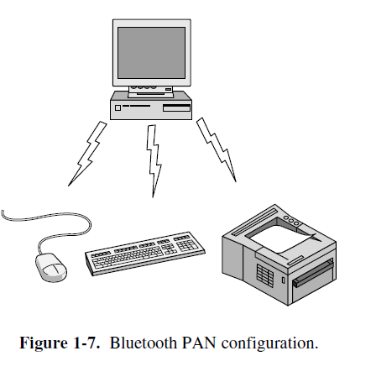
Personal Area Networks
PANs (Personal Area Networks) let devices communicate over the range of a person. A common example is a wireless network that connects a computer with its peripherals. Almost every computer has an attached monitor, keyboard, mouse, and printer. Without using wireless, this connection must be done with cables.
Bluetooth networks use the master-slave paradigm of Fig. 1-7. The system unit (the PC) is normally the master, talking to the mouse, keyboard, etc., as slaves. The master tells the slaves what addresses to use, when they can broadcast, how long they can transmit, what frequencies they can use, and so on. PANs can also be built with other technologies that communicate over short ranges, such as RFID on smartcards and library books.

Slide 10
Local Area Networks
A LAN is a privately owned network that operates within and nearby a single building like a home, office or factory. LANs are widely used to connect personal computers and consumer electronics to let them share resources (e.g., printers) and exchange information. When LANs are used by companies, they are called enterprise networks.
In Wireless LANS, every computer has a radio modem and an antenna that it uses to communicate with other computers. In most cases, each computer talks to a device in the ceiling as shown in Fig. 1-8(a). This device, called an AP (Access Point), wireless router, or base station, relays packets between the wireless computers and also between them and the Internet.
There is a standard for wireless LANs called IEEE 802.11, popularly known as WiFi, which has become very widespread. It runs at speeds anywhere from 11to hundreds of Mbps.
Wired LANs use a range of different transmission technologies. Most of them use copper wires, but some use optical fiber.
Typically, wired LANs run at speeds of 100 Mbps to 1 Gbps, have low delay (microseconds or nanoseconds), and make very few errors. Newer LANs can operate at up to 10 Gbps. Compared to wireless networks, wired LANs exceed them in all dimensions of performance. It is just easier to send signals over a wire or through a fiber than through the air.
The topology of many wired LANs is built from point-to-point links. IEEE 802.3, popularly called Ethernet, is, by far, the most common type of wired LAN.

Slide 11
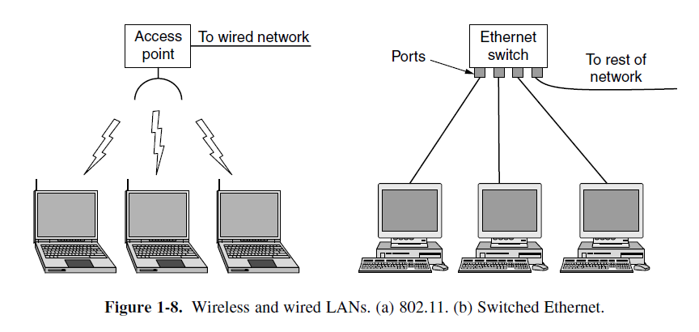
LAN NETWORKS
Fig. 1-8(b) shows a sample topology of switched Ethernet. Each computer speaks the Ethernet protocol and connects to a box called a switch with a point-to-point link. Hence the name. A switch has multiple ports, each of which can connect to one computer. The job of the switch is to relay packets between computers that are attached to it, using the address in each packet to determine which computer to send it to. To build larger LANs, switches can be plugged into each other using their ports.

Slide 12
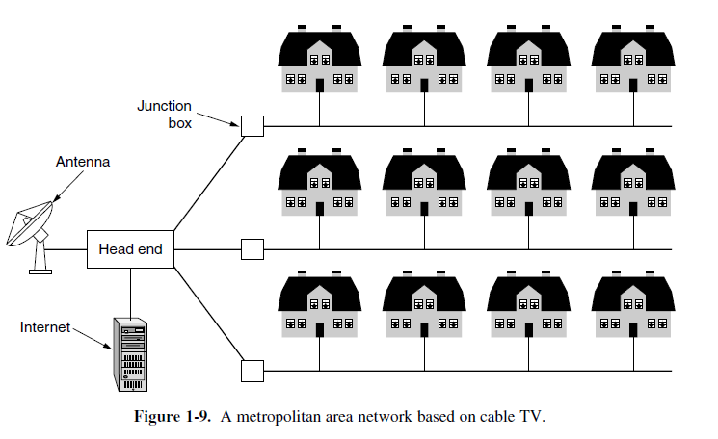
Metropolitan Area Networks
A MAN (Metropolitan Area Network) covers a city. The best-known examples of MANs are the cable television networks available in many cities. These systems grew from earlier community antenna systems used in areas with poor over-the-air television reception.
In those early systems, a large antenna was placed on top of a nearby hill and a signal was then piped to the subscribers’ houses.
Cable television is not the only MAN, though. Recent developments in highspeed wireless Internet access have resulted in another MAN, which has been standardized as IEEE 802.16 and is popularly known as WiMAX.

Slide 13
Wide Area Networks
A WAN (Wide Area Network) spans a large geographical area, often a country or continent. The WAN in Fig. 1-10 is a network that connects offices in Perth, Melbourne, and Brisbane.
Each of these offices contains computers intended for running user (i.e., application) programs. We will follow traditional usage and call these machines hosts.
The rest of the network that connects these hosts is then called the communication subnet, or just subnet for short.
The job of the subnet is to carry messages from host to host, just as the telephone system carries words (really just sounds) from speaker to listener.
Many WANs will in fact be internetworks, or composite networks that are made up of more than one network

Slide 14
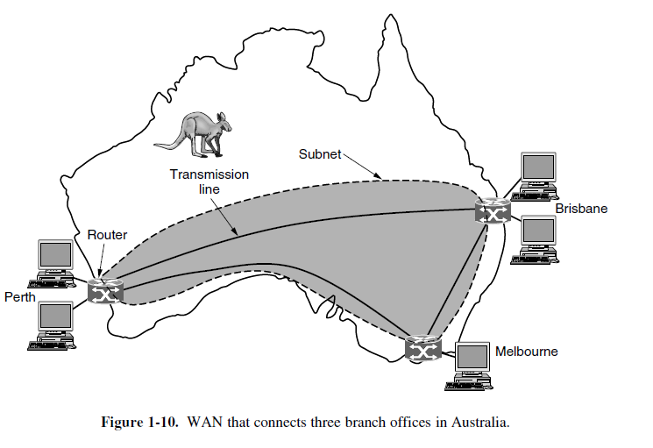
In most WANs, the subnet consists of two distinct components: transmission lines and switching elements. Transmission lines move bits between machines. they can be made of copper wire, optical fiber, or even radio links. Most companies do not have transmission lines lying about, so instead they lease the lines from a telecommunications company. Switching elements, or just switches, are specialized computers that connect two or more transmission lines. when data arrive on an incoming line, the switching element must choose an outgoing line on which to forward them. these switching computers have been called by various names in the past; the name router is now most commonly used.

Slide 15
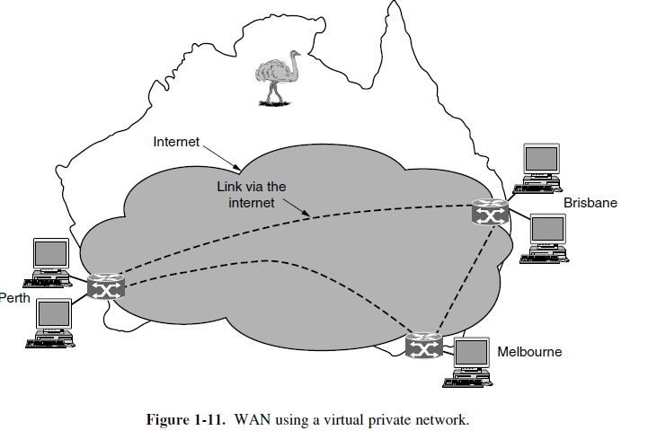
Virtual Private Network
This arrangement, shown in Fig. 1-11, is called a VPN (Virtual Private Network).
Compared to the dedicated arrangement, a VPN has the usual advantage of virtualization, which is that it provides flexible reuse of a resource (Internet connectivity).
Consider how easy it is to add a fourth office to see this. A VPN also has the usual disadvantage of virtualization, which is a lack of control over the underlying resources. With a dedicated line, the capacity is clear. With a VPN your mileage may vary with your Internet service.

Slide 16
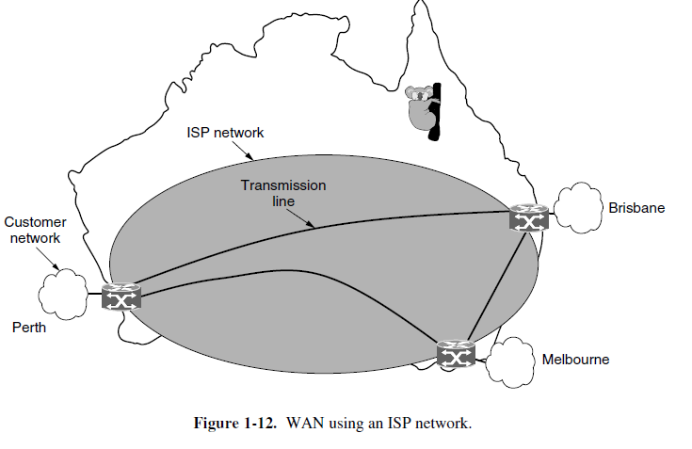
ISP
The second variation is that the subnet may be run by a different company.
The subnet operator is known as a network service provider and the offices are its customers. This structure is shown in Fig. 1-12. The subnet operator will connect to other customers too, as long as they can pay and it can provide service.
Since it would be a disappointing network service if the customers could only send packets to each other, the subnet operator will also connect to other networks that are part of the Internet. Such a subnet operator is called an ISP (Internet Service Provider) and the subnet is an ISP network.
Its customers who connect to the ISP receive Internet service. How the network makes the decision as to which path to use is called the routing algorithm.
Many such algorithms exist. How each router makes the decision as to where to send a packet next is called the forwarding algorithm.

Slide 17
Internetworks
A collection of interconnected networks is called an internetwork or internet.
The Internet uses ISP networks to connect enterprise networks, home networks, and many other networks.
We know that an internet is formed when distinct networks are interconnected.
The general name for a machine that makes a connection between two or more networks and provides the necessary translation, both in terms of hardware and software, is a gateway.
Gateways are distinguished by the layer at which they operate in the protocol hierarchy

